Slide 1
Computer Vision with Embedded Machine Learning
Introduction to Embedded Machine Learning

Slide 2
What Is ML?

Slide 3

Artificial Intelligence
“[AI is] the science and engineering of making intelligent machines”
- John McCarthy, 1955
Machine Learning
In 1959, Arthur Samuel coined “machine learning” to refer to any computer program that learns from experience.

Slide 4

ML works by Training a model
CAT
ML
DOG
RULES
CAT
DOG
INPUTS
LABELS
Notes:
So, for a concrete example, we could give our machine lots of pictures of cats and dogs. And rather than just asking the machine to figure it out with no hints, we can first start by giving the machine some practice material. We call this “training data.” (We’ll talk about this later.) Then it can learn. Okay, I see this blue animal. Let’s make a guess. I guessed “dog.” Was that right? Let’s check the answers that the user provided. Nope, I got it wrong. I should improve my guess. Do this again and again until it starts getting things mostly right, and now the computer has learned its own rules!

Slide 5
After it’s learned…
NEW
UNLABELED
Model
RULES
INPUTS
Notes:
So now, if we provide new, never before seen, pictures of a different cat and dog. Hopefully our model was trained well enough to recognize, to generalize, what each might be so that it can give us an answer, a label.

Slide 6
After it’s learned you can make predictions:
NEW
UNLABELED
NEW
Model
DOG
CAT
RULES
INPUTS
ANSWERS (LABELS)
Notes:
If we did a good job in training. If we gave it enough time to practice and learn to recognize patterns, hopefully, we now have the right labels at the output for these new inputs we gave the machine. Simple enough, right?

Slide 7
What Is Embedded ML? (TinyML)

Slide 8

What is Embedded ML (TinyML)?
TinyML
Fastest-growing field of ML
Algorithms, hardware, software
Notes:
Tiny machine learning (TinyML) is a fast-growing field of machine learning technologies and applications including algorithms, hardware, and software capable of performing on-device sensor data analytics at extremely low power consumption, typically in the mW range and below, and hence enabling a variety of always-on ML use-cases on battery-operated devices.
https://thenounproject.com/search/?q=growing&i=1675838
https://thenounproject.com/search/?q=microprocessor&i=2095426
https://thenounproject.com/search/?q=power+switch&i=2698533
https://thenounproject.com/search/?q=coin+battery&i=221396

Slide 9
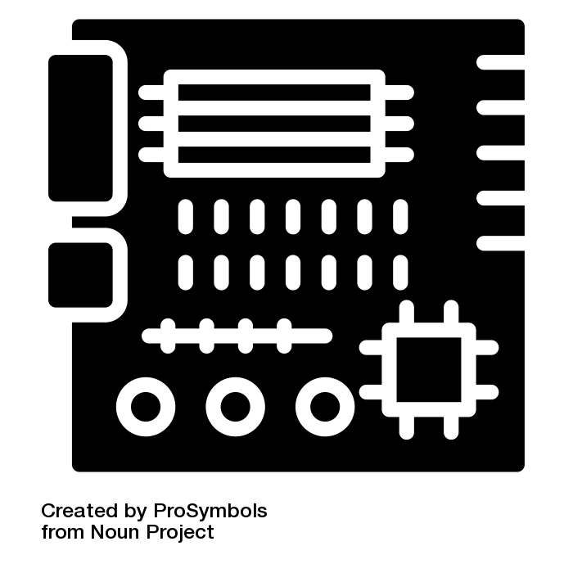

What is Embedded ML (TinyML)?
TinyML
Fastest-growing field of ML
Algorithms, hardware, software
On-device sensor analytics
Battery-operated
Low power consumption
Notes:
Tiny machine learning (TinyML) is a fast-growing field of machine learning technologies and applications including algorithms, hardware, and software capable of performing on-device sensor data analytics at extremely low power consumption, typically in the mW range and below, and hence enabling a variety of always-on ML use-cases on battery-operated devices.
https://thenounproject.com/search/?q=growing&i=1675838
https://thenounproject.com/search/?q=microprocessor&i=2095426
https://thenounproject.com/search/?q=power+switch&i=2698533
https://thenounproject.com/search/?q=coin+battery&i=221396

Slide 10
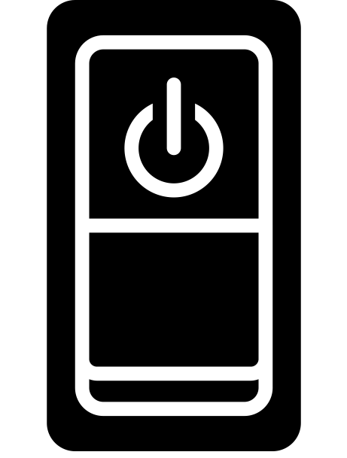
What is Embedded ML (TinyML)?
TinyML
Fastest-growing field of ML
Algorithms, hardware, software
On-device sensor analytics
Battery-operated
Low power consumption
Always-on ML
Notes:
Tiny machine learning (TinyML) is a fast-growing field of machine learning technologies and applications including algorithms, hardware, and software capable of performing on-device sensor data analytics at extremely low power consumption, typically in the mW range and below, and hence enabling a variety of always-on ML use-cases on battery-operated devices.
https://thenounproject.com/search/?q=growing&i=1675838
https://thenounproject.com/search/?q=microprocessor&i=2095426
https://thenounproject.com/search/?q=power+switch&i=2698533
https://thenounproject.com/search/?q=coin+battery&i=221396

Slide 11
What is Tiny Machine Learning (TinyML)?
Putting ML on embedded devices!
TinyML
Fastest-growing field of ML
Algorithms, hardware, software
On-device sensor analytics
Battery-operated
Low power consumption
Always-on ML
Notes:
Tiny machine learning (TinyML) is a fast-growing field of machine learning technologies and applications including algorithms, hardware, and software capable of performing on-device sensor data analytics at extremely low power consumption, typically in the mW range and below, and hence enabling a variety of always-on ML use-cases on battery-operated devices.
https://thenounproject.com/search/?q=growing&i=1675838
https://thenounproject.com/search/?q=microprocessor&i=2095426
https://thenounproject.com/search/?q=power+switch&i=2698533
https://thenounproject.com/search/?q=coin+battery&i=221396

Slide 12
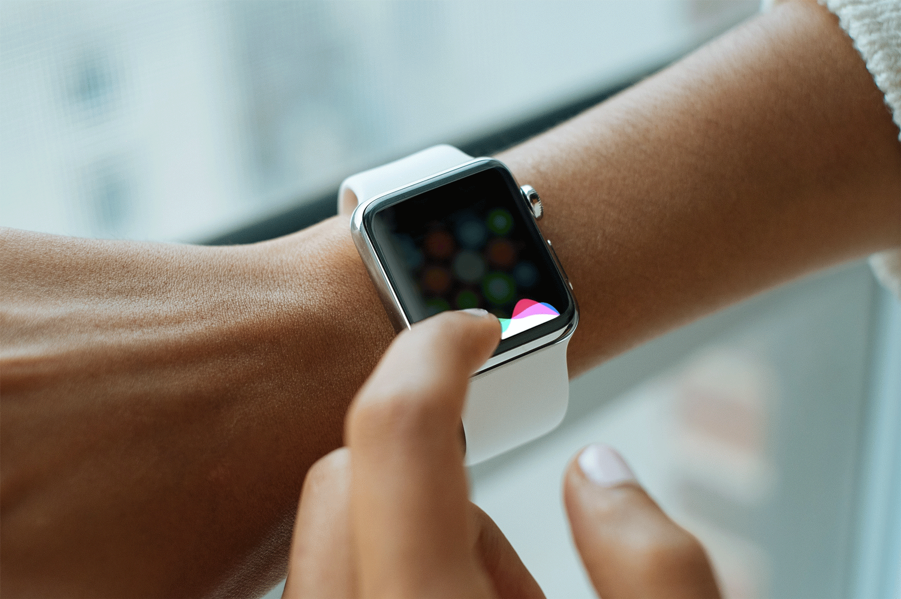
Notes:
Or perhaps you have said Hey Siri!
===
https://search.creativecommons.org/photos/7df7b01f-ccba-4c45-ab7d-a421c89b3913 Edits to make it a GIF my own (Dhilan R)

Slide 13
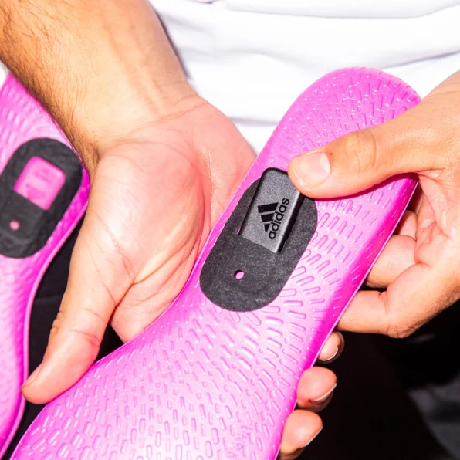
Kicking
Penalty kicking
Passing
Dribbling
...

Slide 14
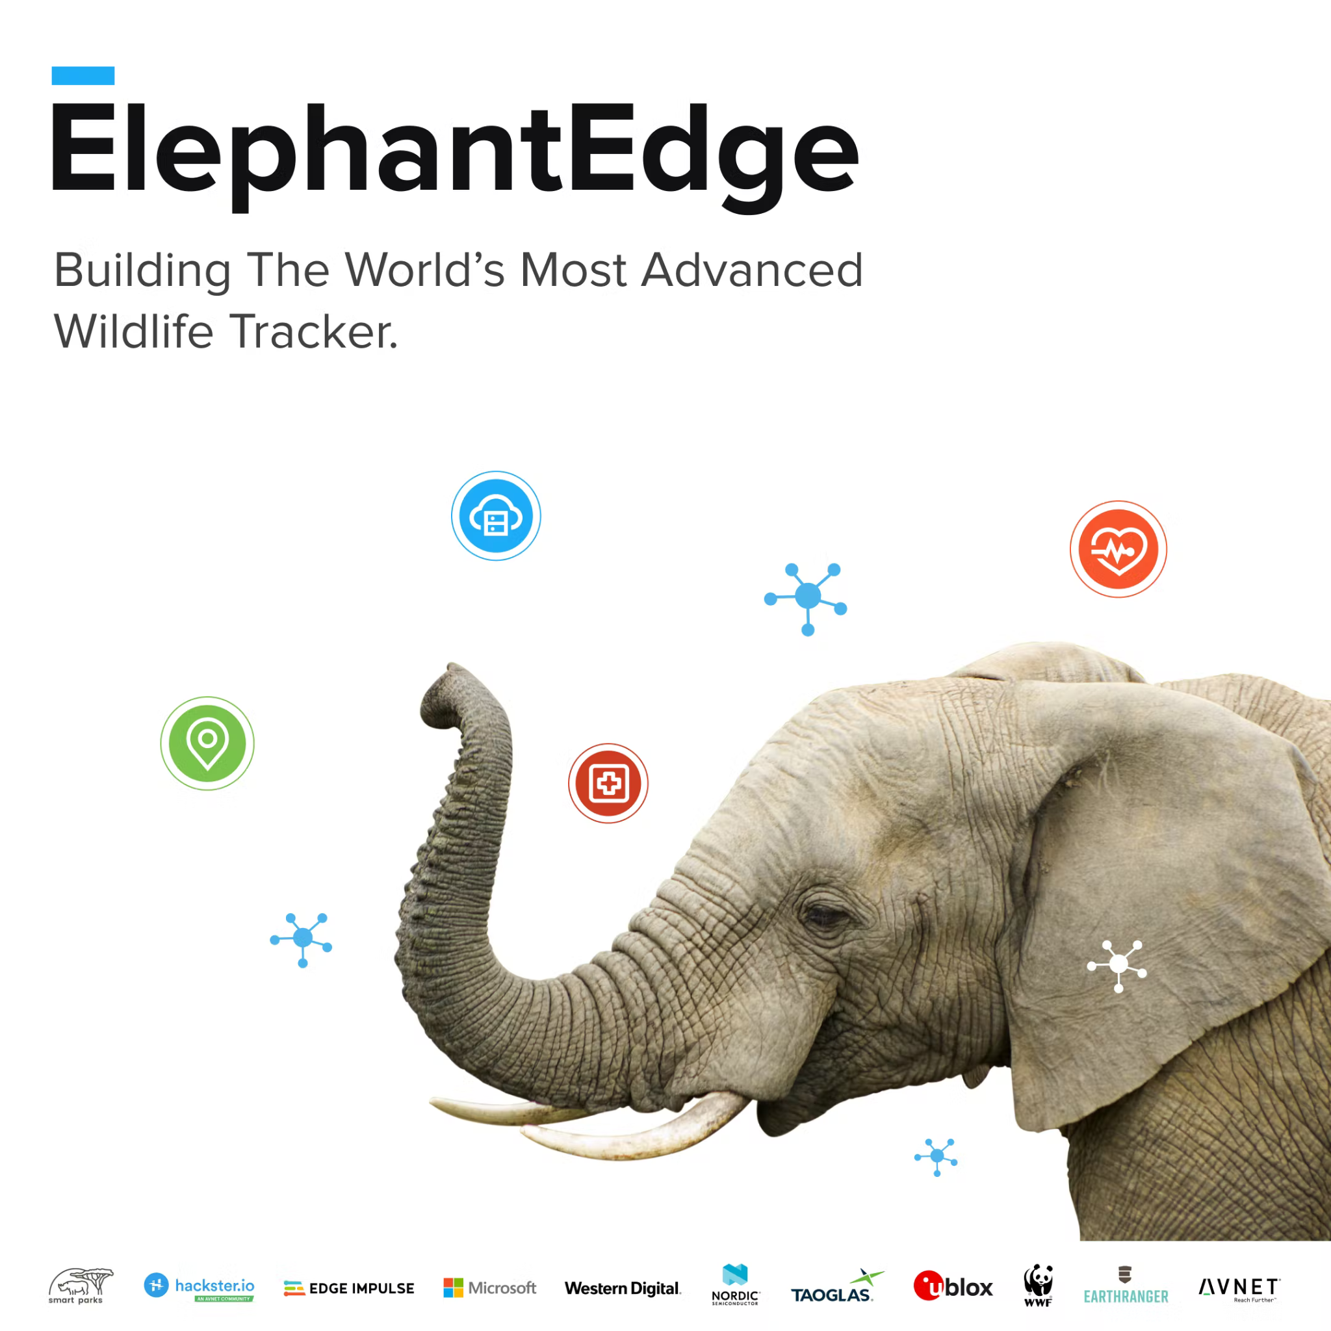
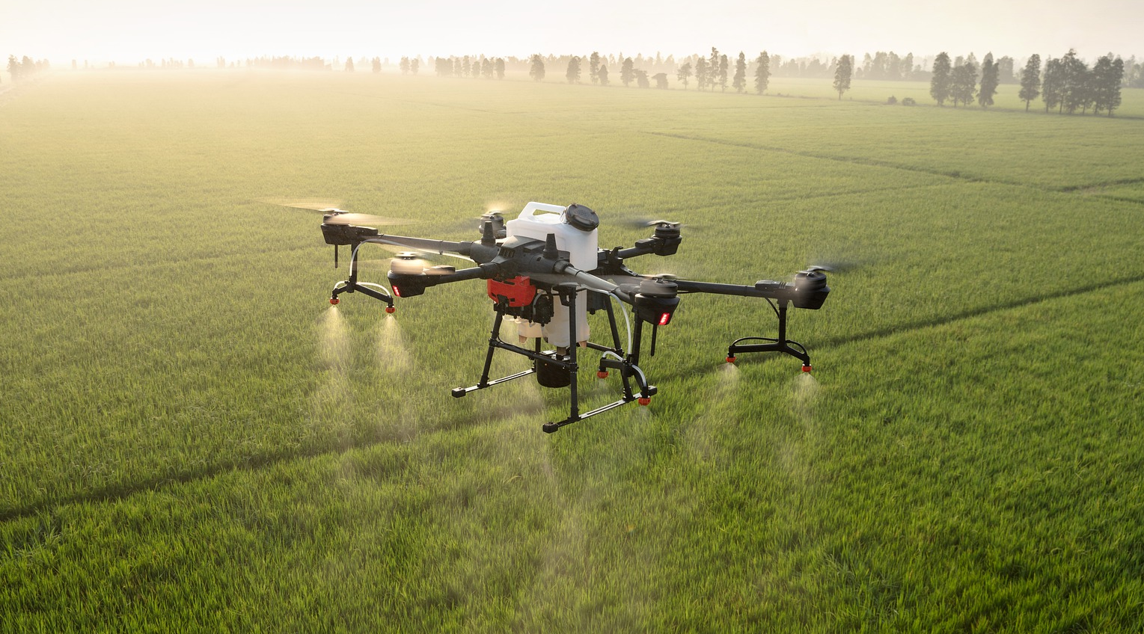
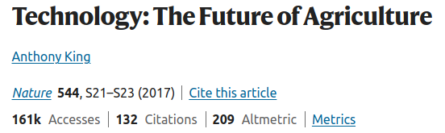
Promising Social Applications of TinyML
Wildlife conservation
Agriculture
May be able to reduce agrichemical use to 0.1% of conventional blanket spraying
Notes:
https://pixabay.com/photos/dji-drone-plant-protection-drone-5331597/
https://pixabay.com/photos/elephants-amboseli-elephant-kenya-4499210/
https://www.nature.com/articles/544S21a
Reminder from course 1, define AI for social good
the design, development, and deployment of AI systems in ways that (i) prevent, mitigate or resolve problems adversely affecting human life and/or the wellbeing of the natural world, and/or (ii) enable socially preferable and/or environmentally sustainable developments.

Slide 15
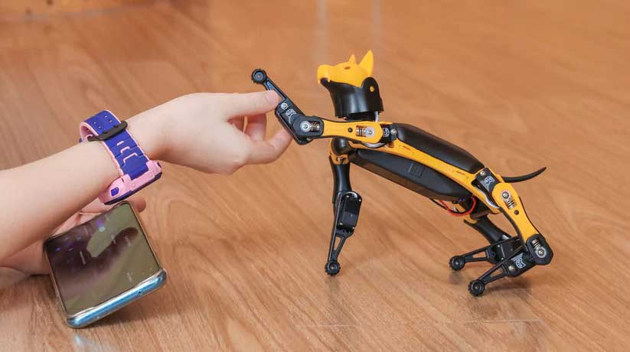
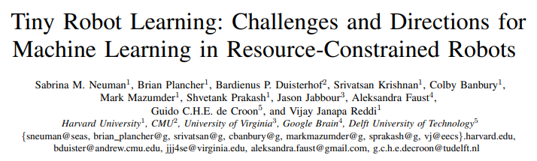
And many more!
https://arxiv.org/pdf/2205.05748.pdf
Notes:
https://pixabay.com/photos/dji-drone-plant-protection-drone-5331597/
https://pixabay.com/photos/elephants-amboseli-elephant-kenya-4499210/
https://www.nature.com/articles/544S21a
Reminder from course 1, define AI for social good
the design, development, and deployment of AI systems in ways that (i) prevent, mitigate or resolve problems adversely affecting human life and/or the wellbeing of the natural world, and/or (ii) enable socially preferable and/or environmentally sustainable developments.

Slide 16
Why Tiny?

Slide 17
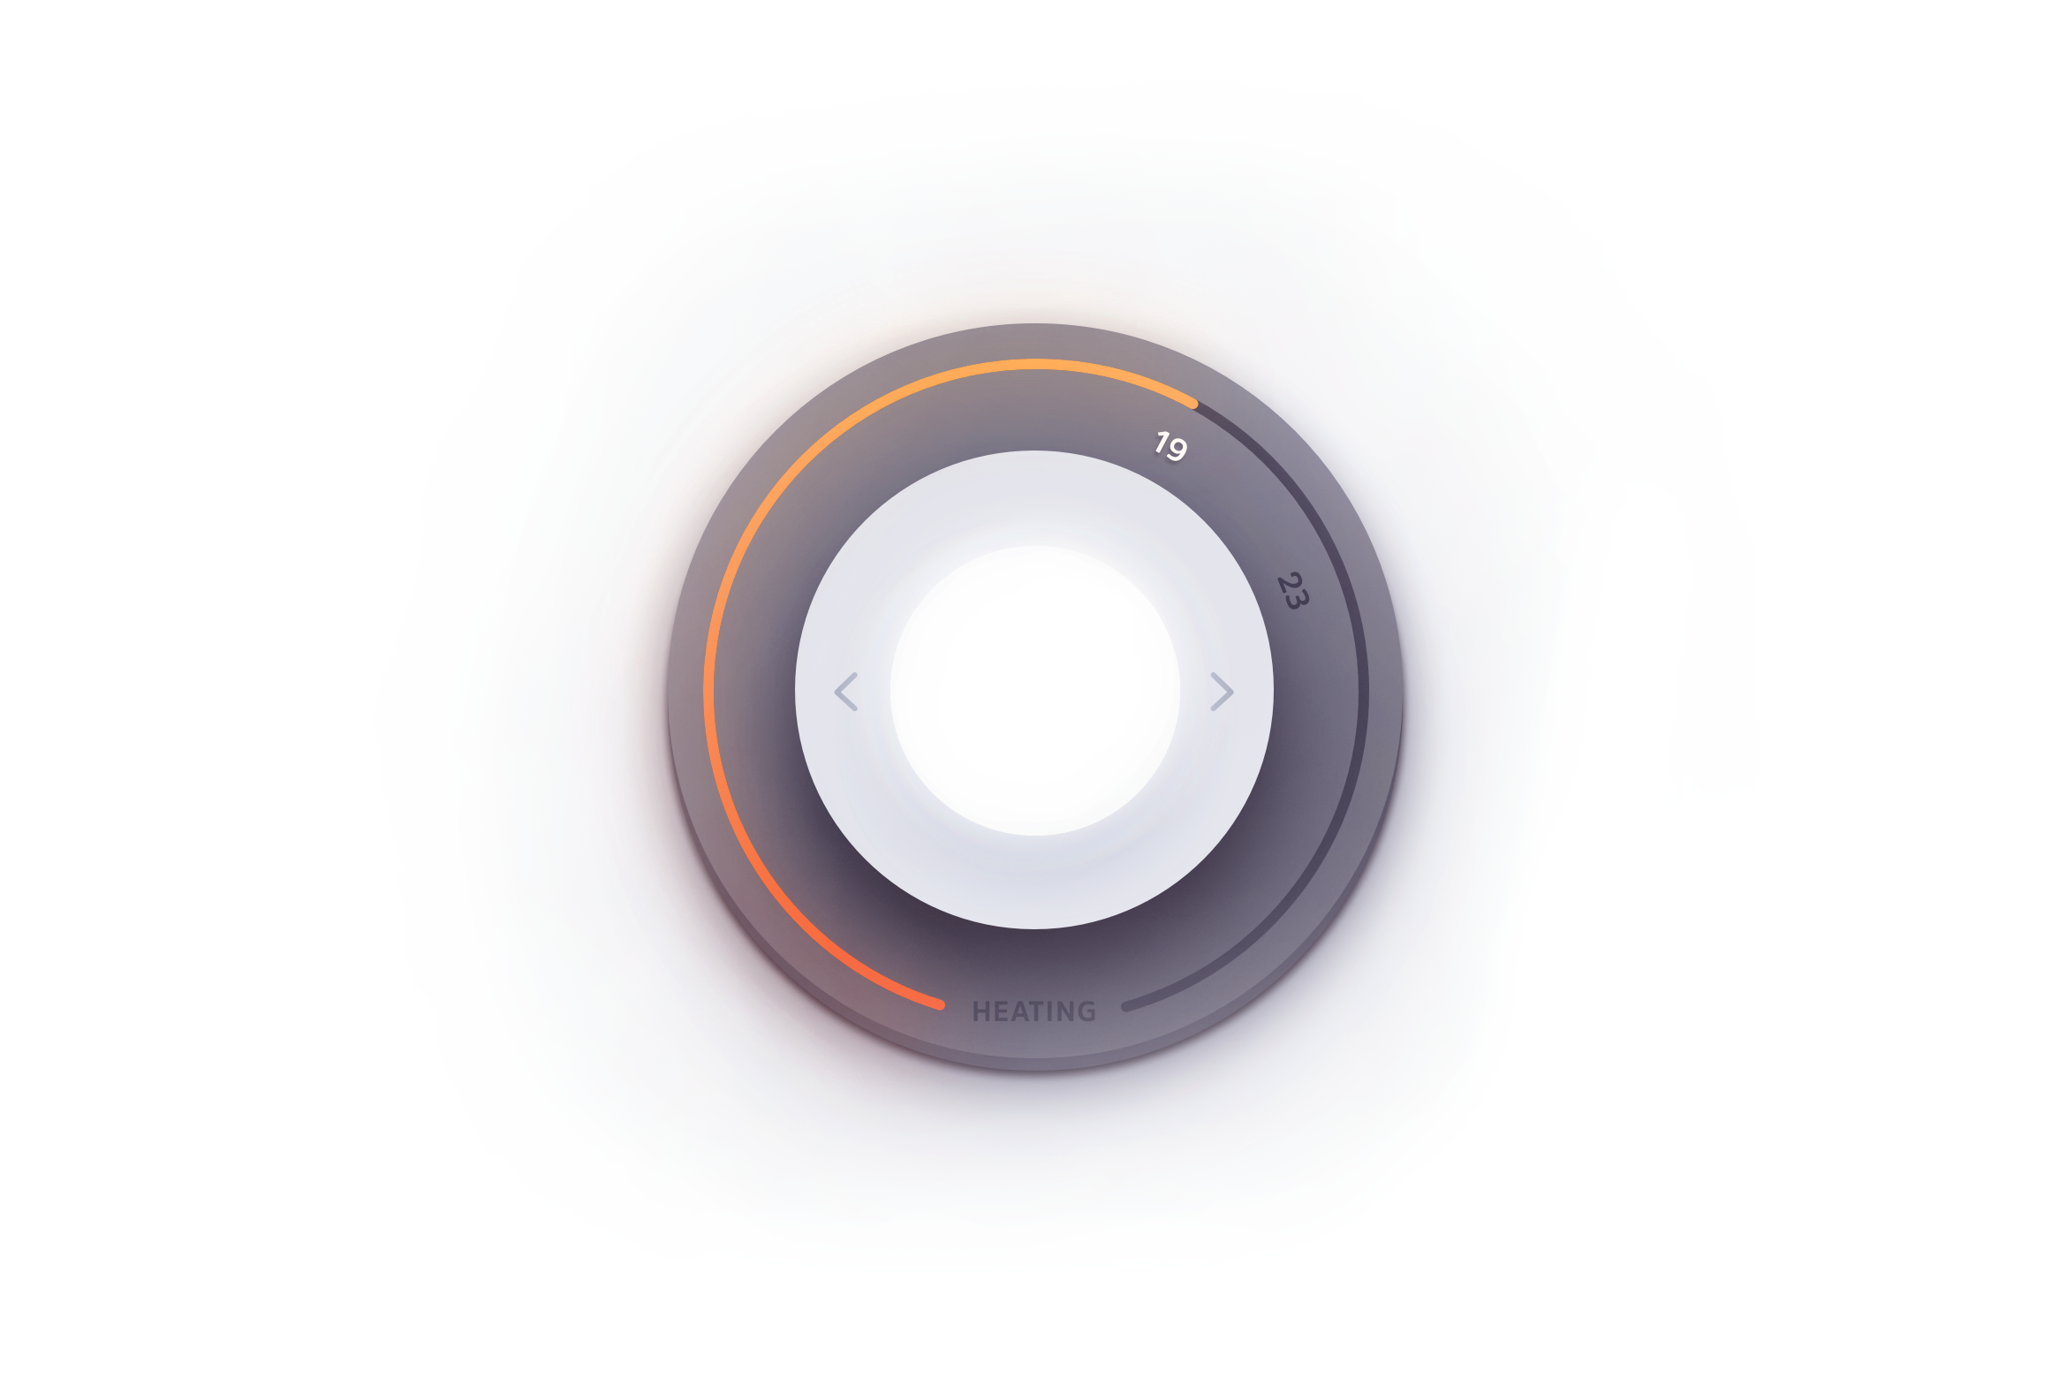
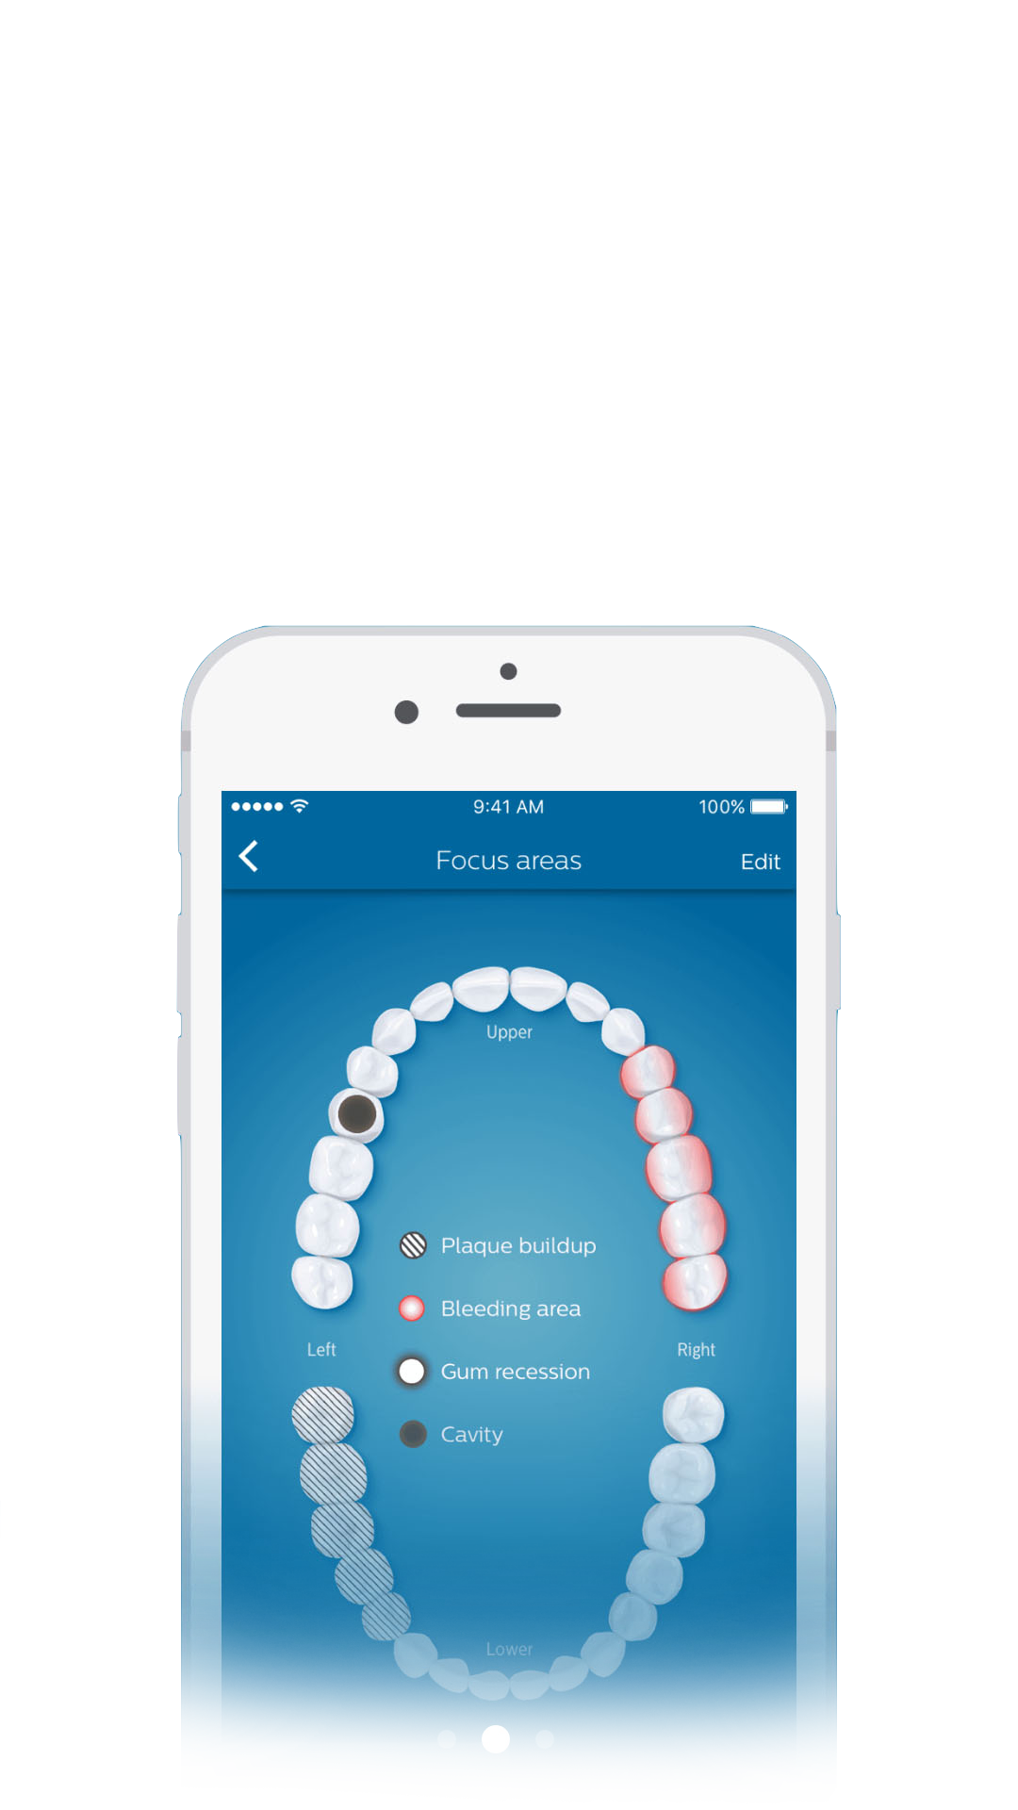
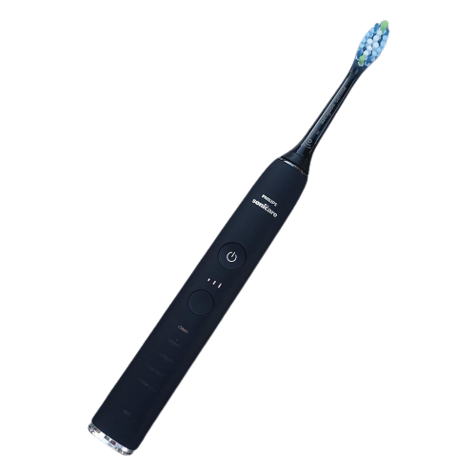
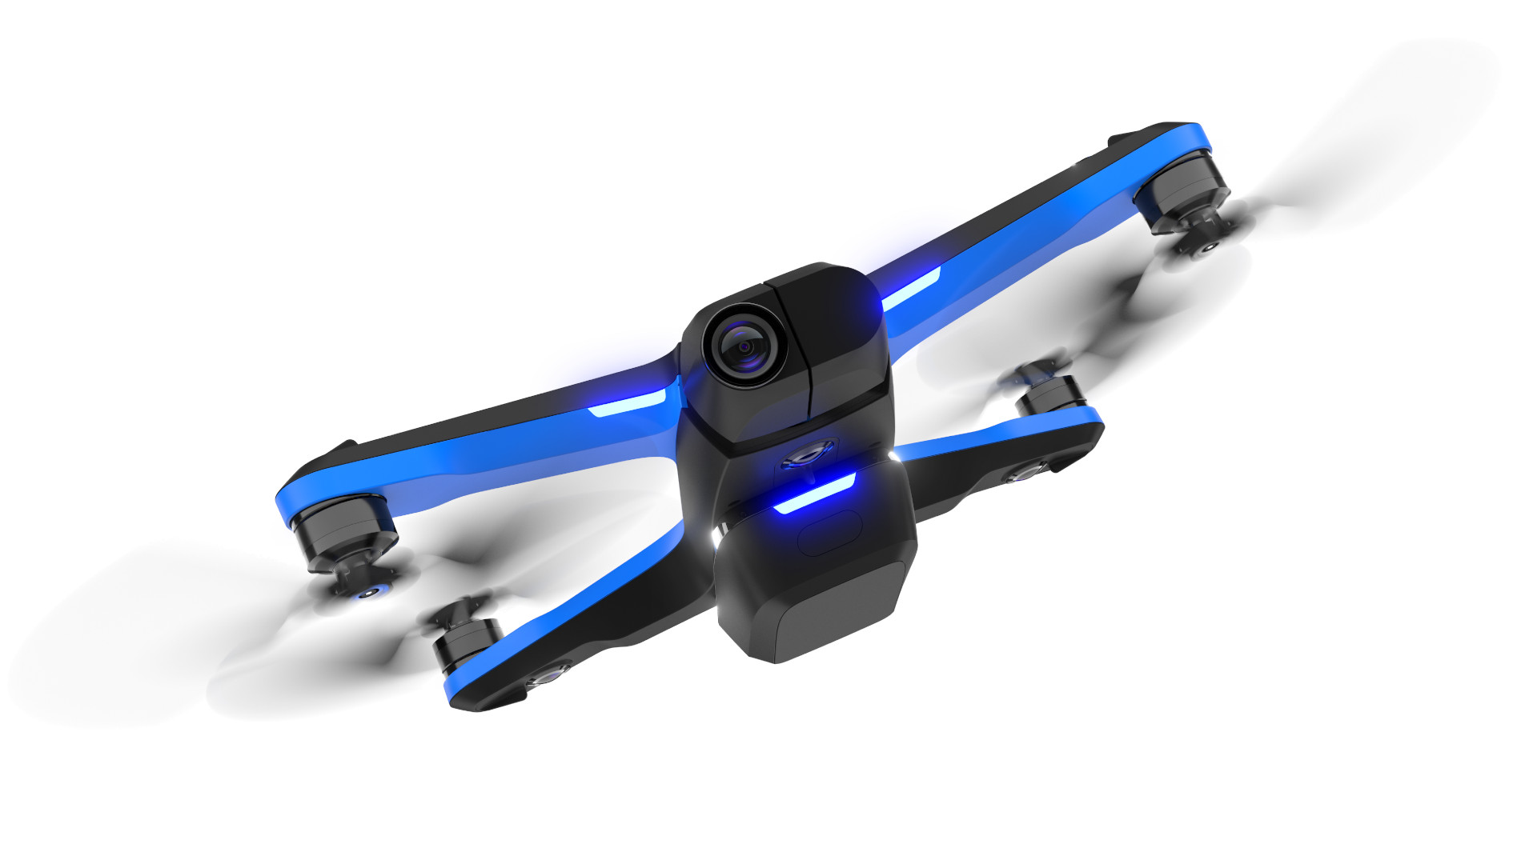

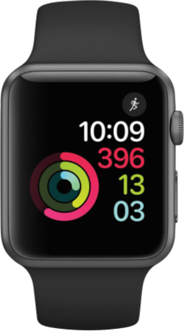
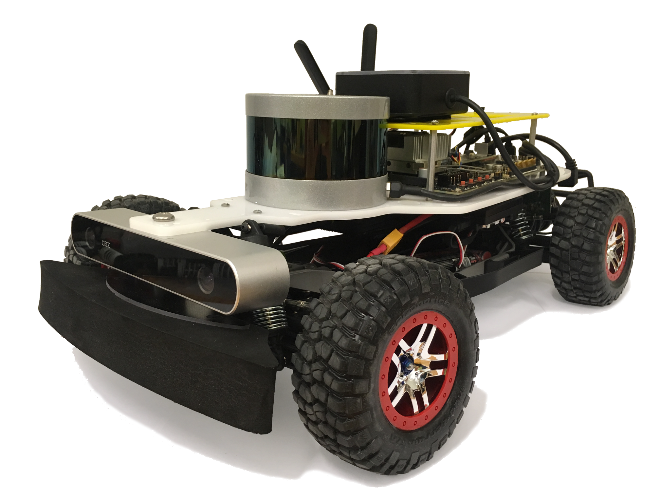
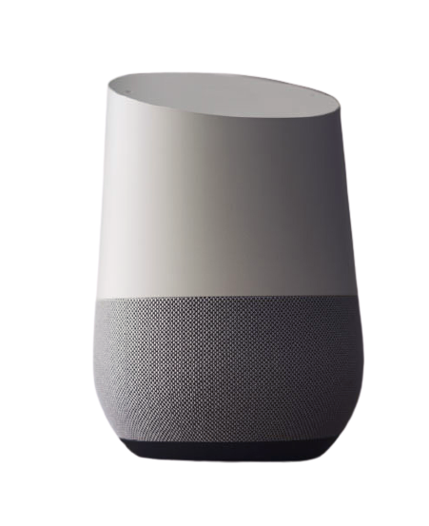
IoT 2.0: Intelligence on Things
IoT 1.0:
Internet
of Things
nest
Google Assistant

Slide 18
No Good Data Left Behind
5 Quintillion
bytes of data produced every day by IoT
<1%
of unstructured data is analyzed or used at all
Source: Harvard Business Review, What’s Your Data Strategy?, April 18, 2017
Cisco, Internet of Things (IoT) Data Continues to Explode Exponentially. Who Is Using That Data and How?, Feb 5, 2018

Slide 19
IoT 2.0: Intelligence on Things
IoT 1.0:
Internet
of Things
B
L
E
R
P

Slide 20
IoT 2.0: Intelligence on Things
IoT 1.0:
Internet
of Things
Bandwidth
Latency
Energy
Reliability
Privacy
Side Note: I’ve also seen the E represent Economics

Slide 21
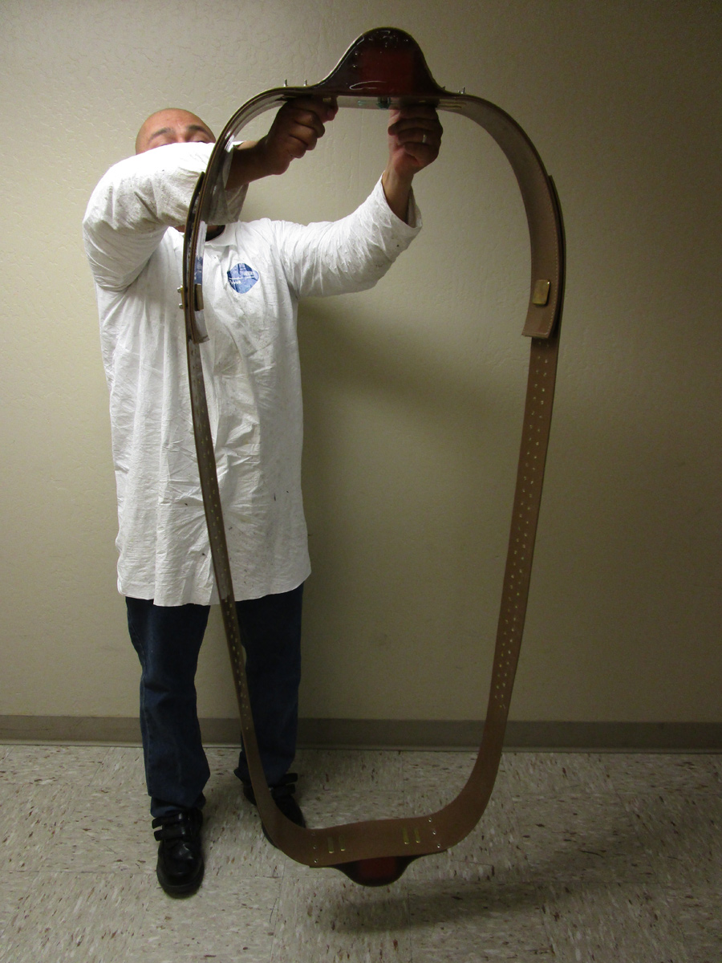
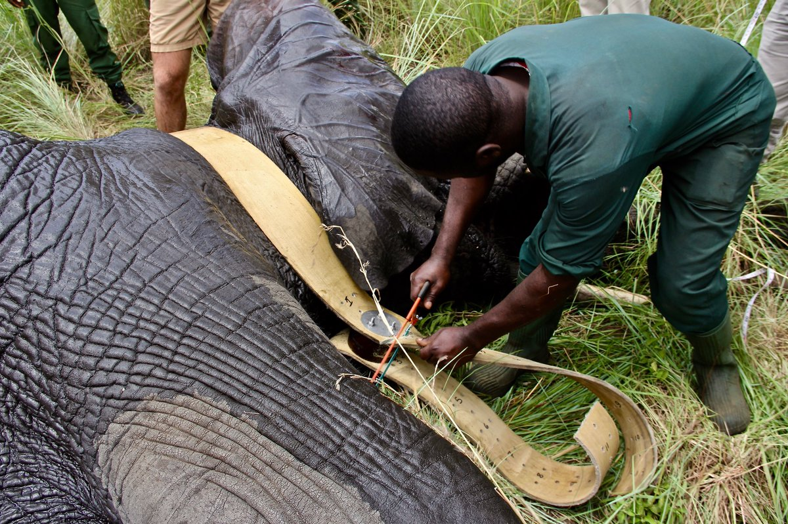
IoT 2.0: Intelligence on Things
IoT 1.0:
Internet
of Things
Bandwidth
Latency
Energy
Reliability
Privacy
Battery Life is only O(months) and only sends GPS signal

Slide 22
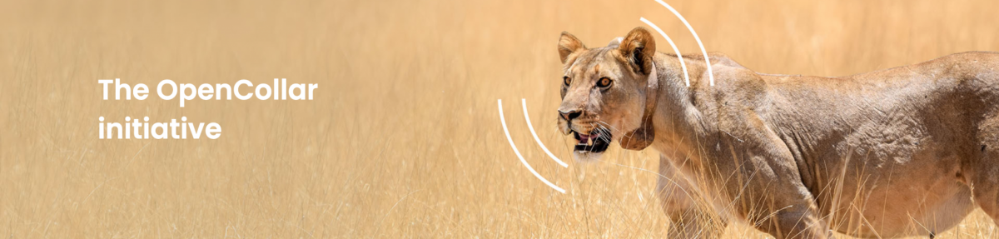
IoT 2.0: Intelligence on Things
IoT 1.0:
Internet
of Things
Bandwidth
Latency
Energy
Reliability
Privacy

Slide 23
IoT 2.0: Intelligence on Things
IoT 1.0:
Internet
of Things
Bandwidth
Latency
Energy
Reliability
Privacy
Google Assistant

Slide 24
IoT 2.0: Intelligence on Things
IoT 1.0:
Internet
of Things
Bandwidth
Latency
Energy
Reliability
Privacy
Google Assistant

Slide 25
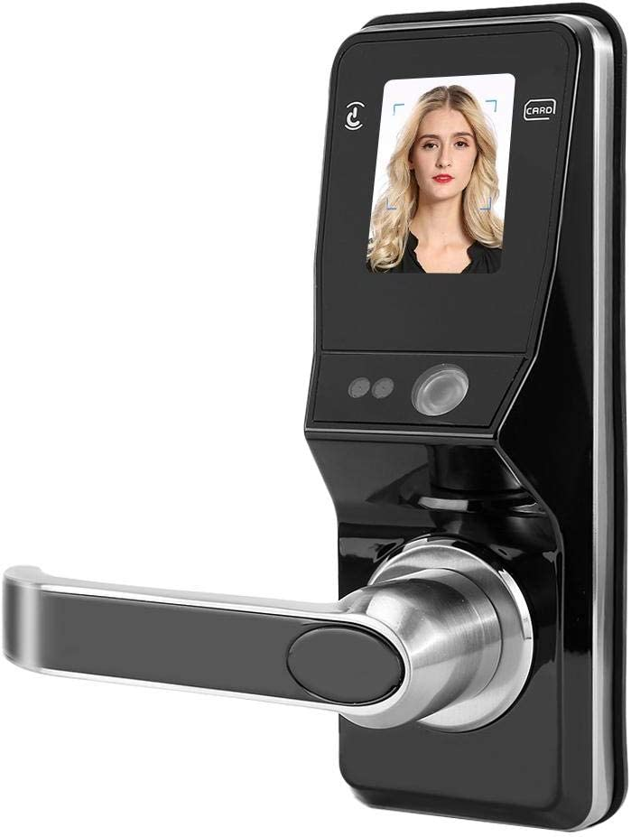
IoT 2.0: Intelligence on Things
IoT 1.0:
Internet
of Things
Bandwidth
Latency
Energy
Reliability
Privacy

Slide 26
IoT 2.0: Intelligence on Things
IoT 1.0:
Internet
of Things
Bandwidth
Latency
Energy
Reliability
Privacy
TinyML to the rescue!

Slide 27
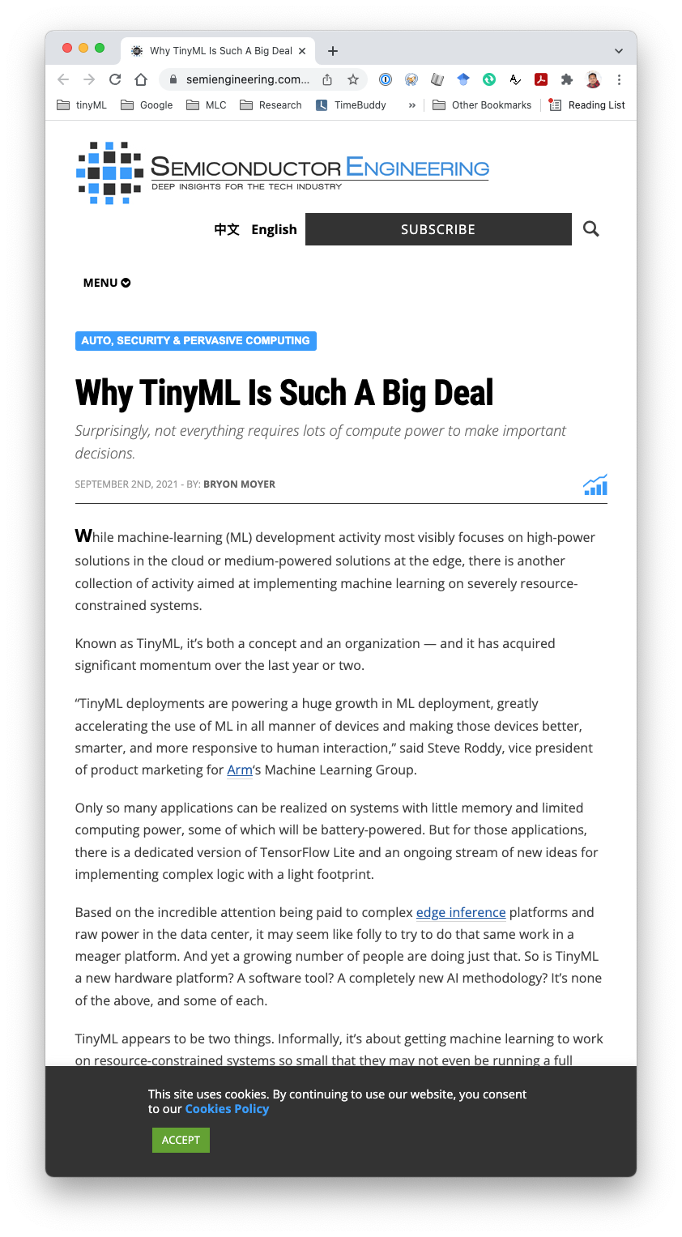
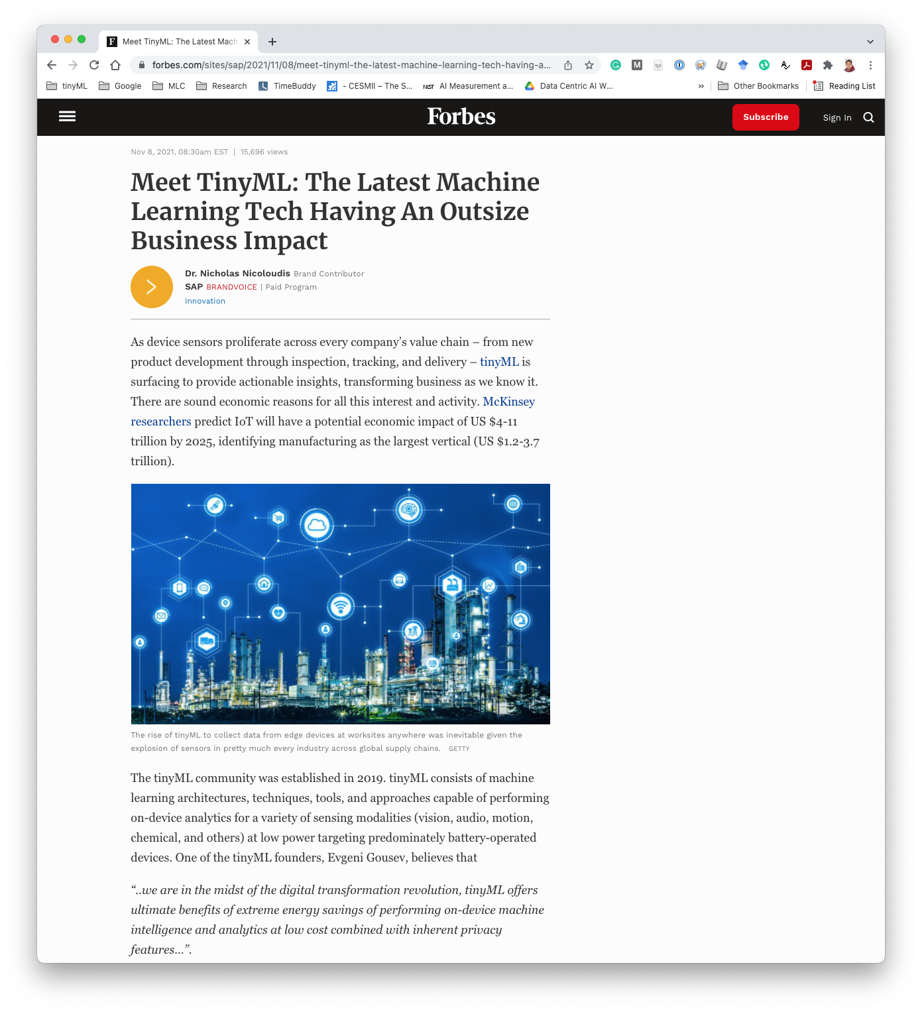
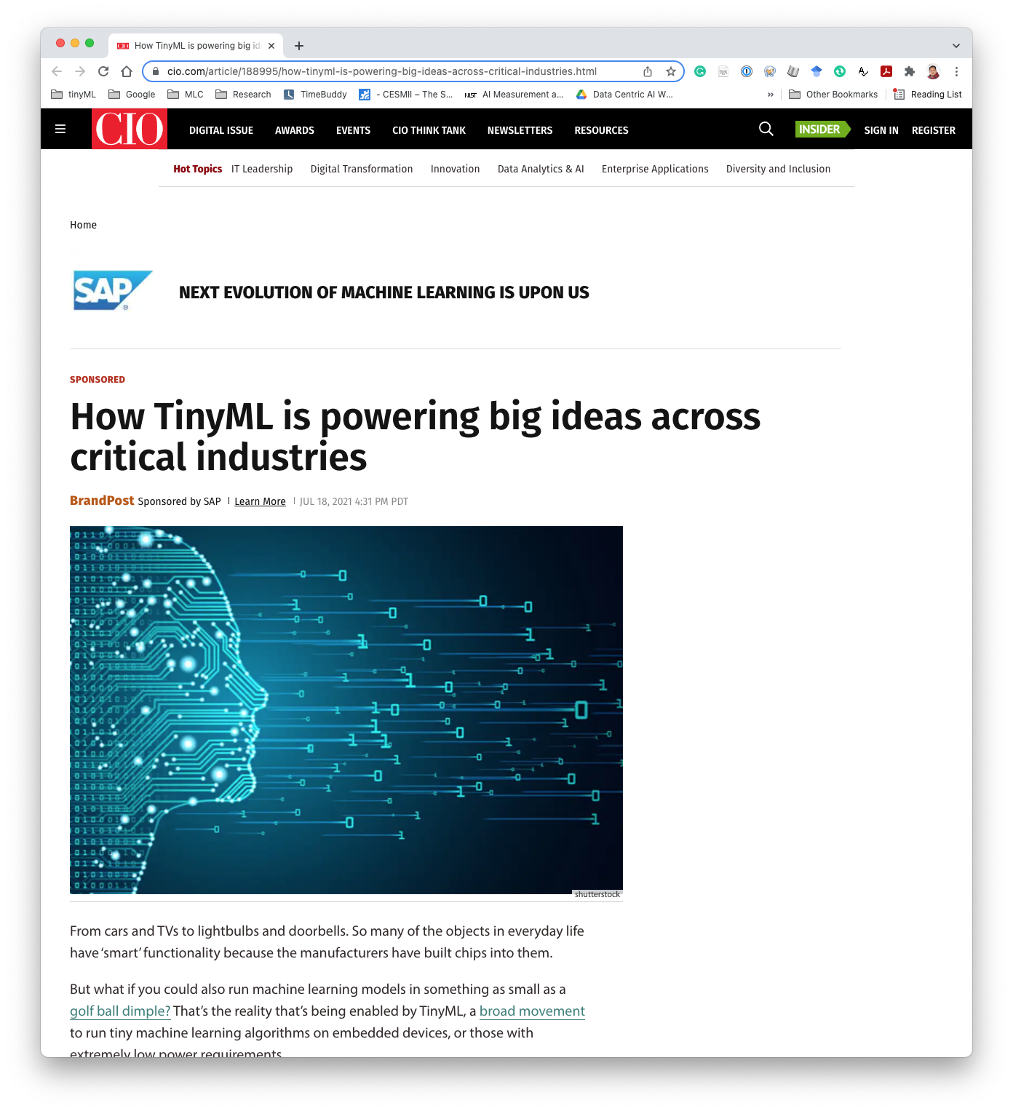
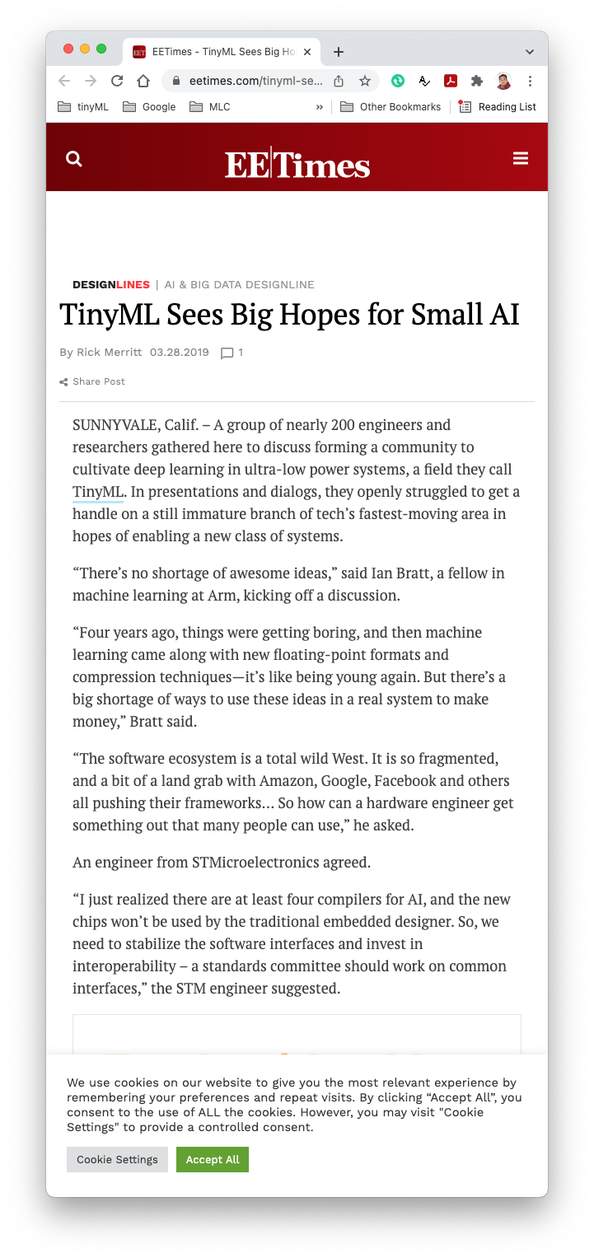
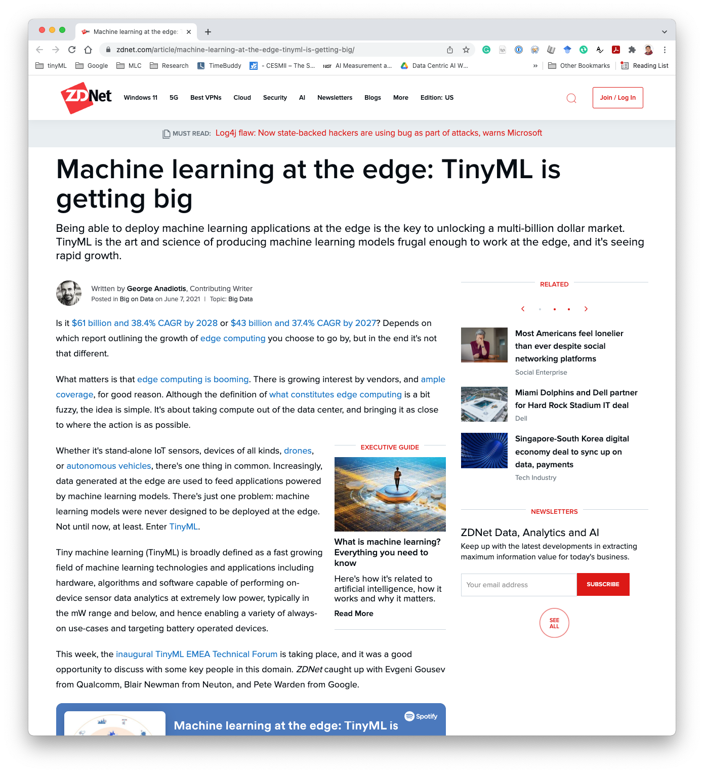
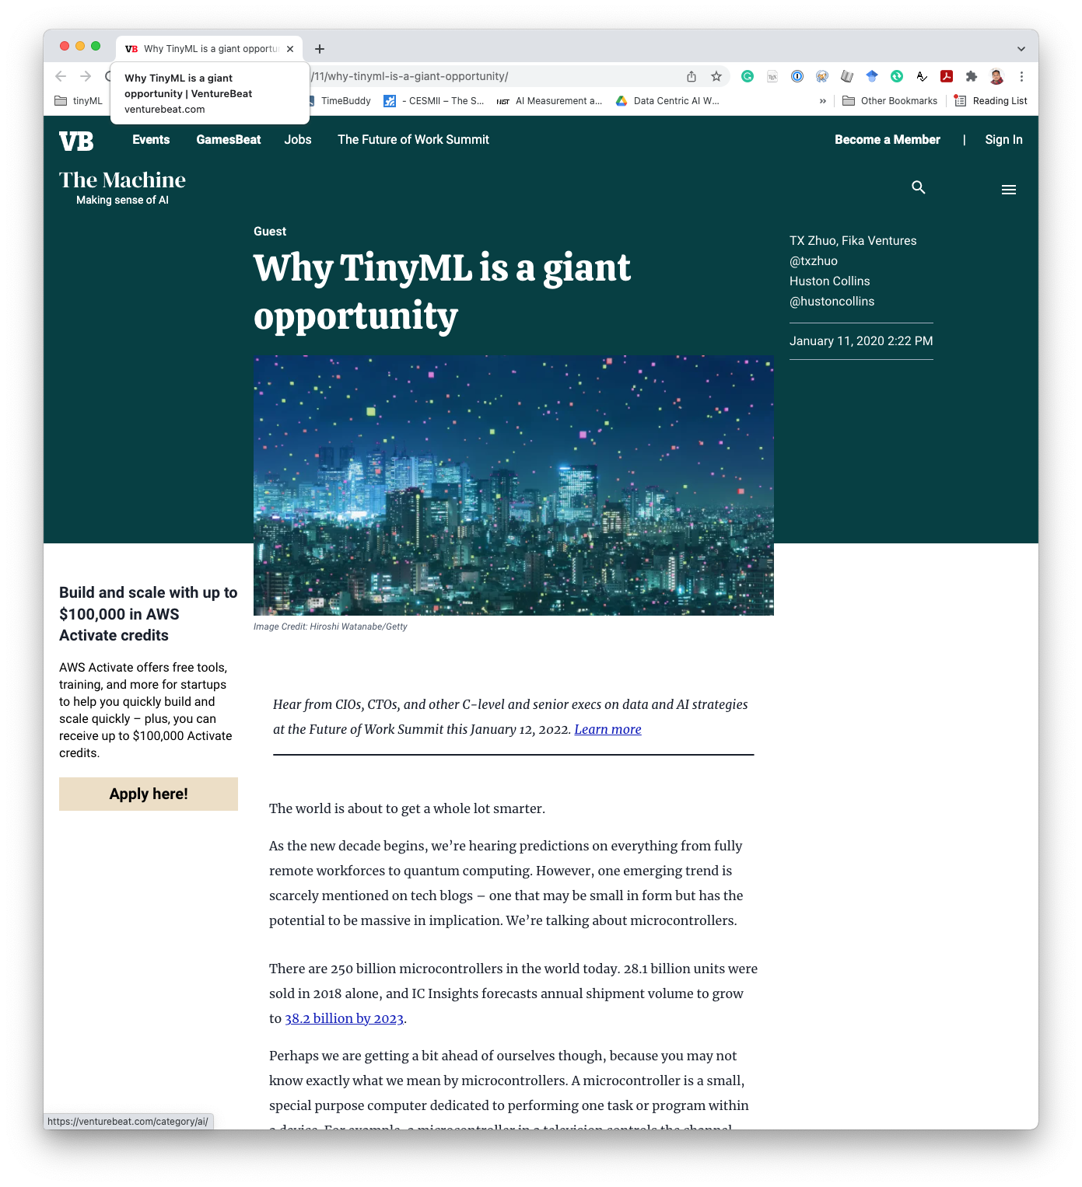

Slide 28
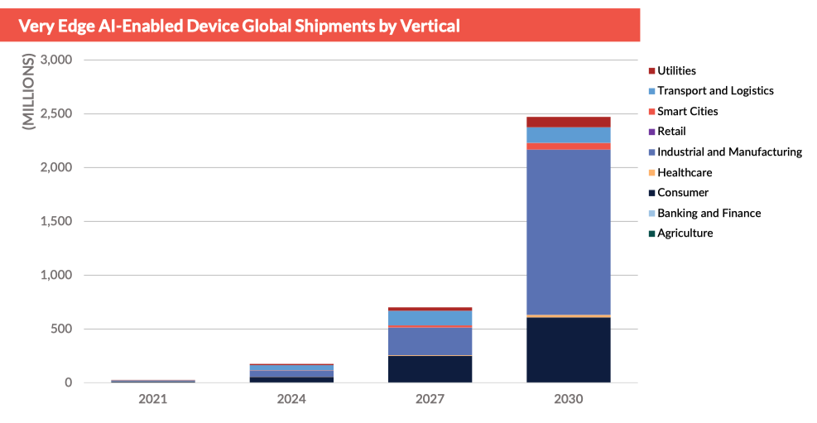
Market Forecast
Source: ABI Research: TinyML

